Slide 1
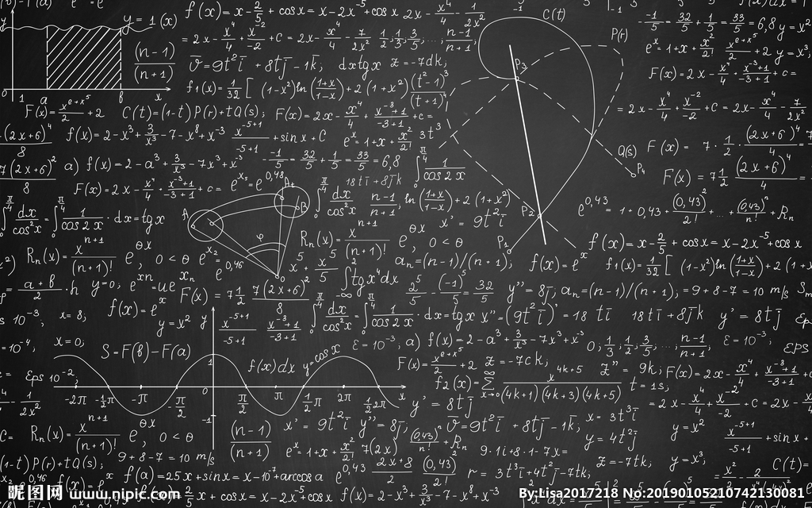

Welcome to Algebra1
Made by Chinese Boy.
Are You Ready!
Math is Future!
Future is Work!
Work is Money!
So, Math=Money!

Slide 2
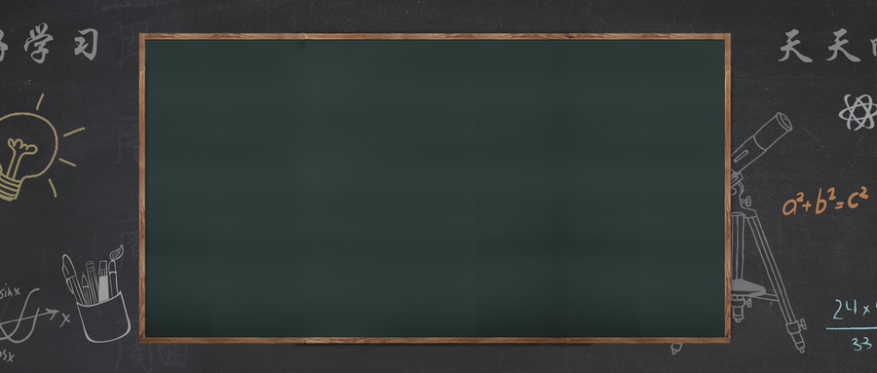
1. What is Algebra? It is not 1+1=2!
Algebra will guide you through among other things expressions, systems of equations, functions, real numbers, inequalities, exponents, polynomials, radical and rational expressions.
2. Why we have to learn Algebra?
Learning Algebra helps to develop your critical thinking skills. This is the foundation for learning professional knowledge in the future. The most important is, it can help you make a lot of money.

Slide 3

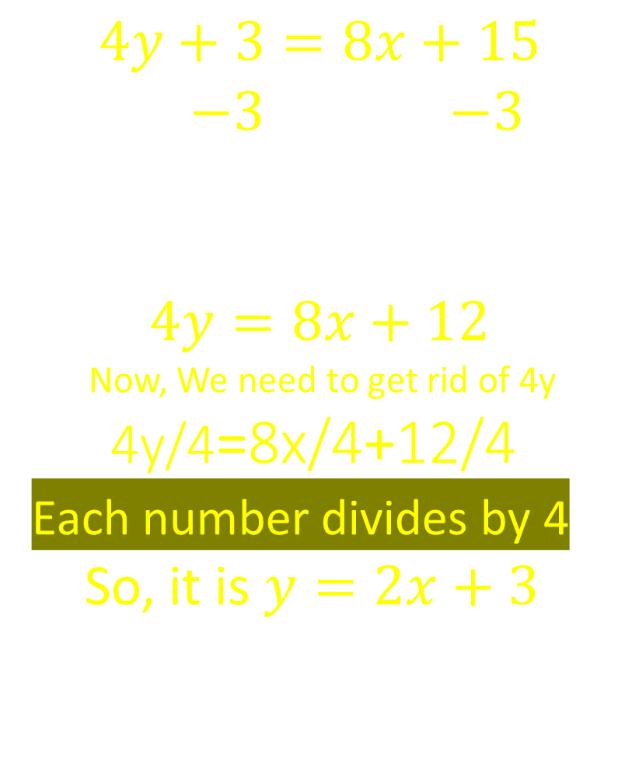


Solving
$Y+3=6x+7$
$$Y+3=6x+7$$
$$−3 −3$$
$$Y=6x+4$$
$4y+3=8x+15$
$$4y+3=8x+15$$
$−3$ $−3$
$$4y=8x+12$$
Now, We need to get rid of 4y
4y/4=8x/4+12/4
Each number divides by 4
So, it is $y=2x+3$

Slide 4

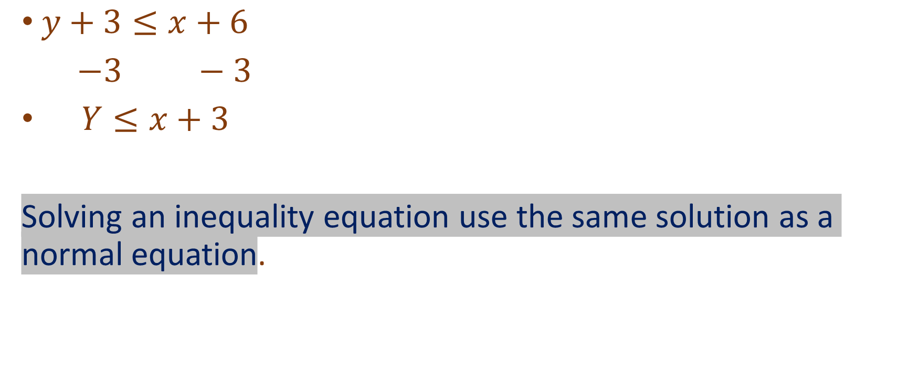
Inequality equations
$y+3≤x+6$
$−3 −3$
$Y≤x+3$
Solving an inequality equation use the same solution as a normal equation.

Slide 5


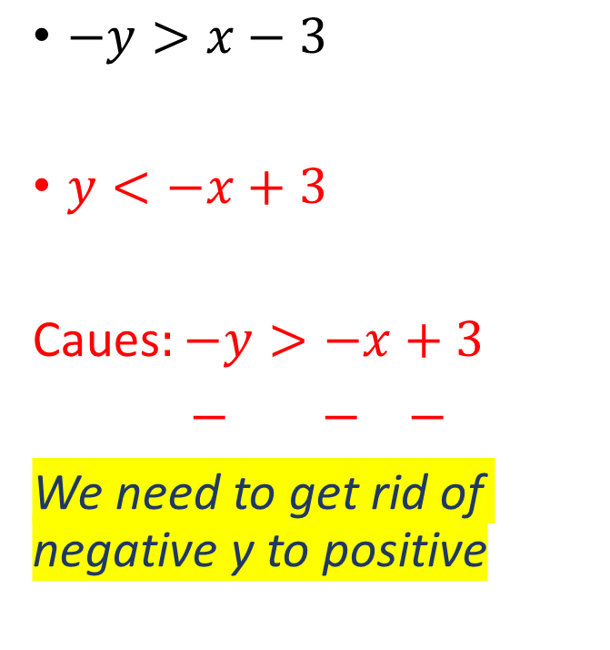
Key !
$−y>x−3$
$y<−x+3$
Caues$:−y>−x+3$
$− − −$
We need to get rid of negative y to positive
$$−y+5>x−3$$
$−5 −5$
$−y>x−8$
$− − −$
$$y<−x+8$$

Slide 6
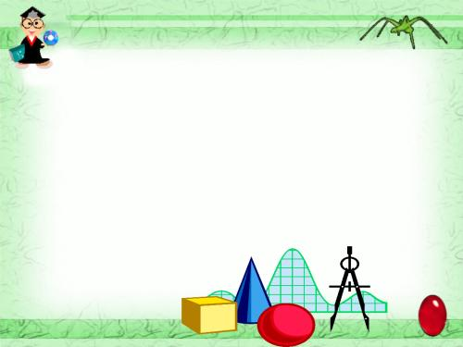
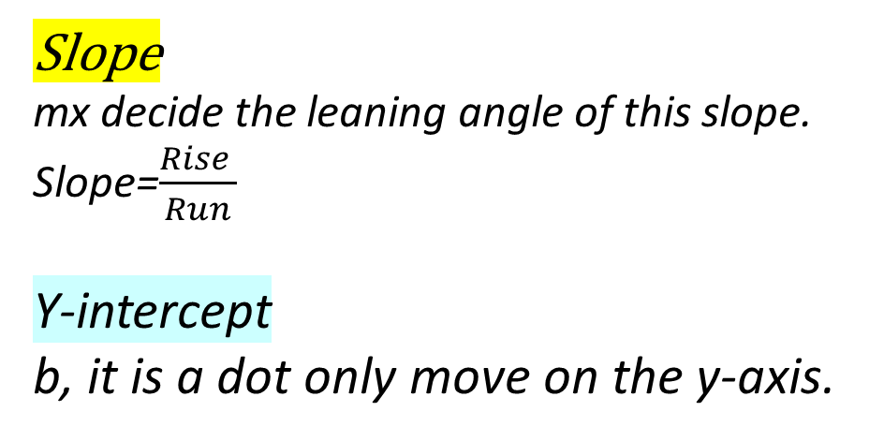

Graphing 1
  $Y=mx+b$
  slope y-intercept
Slope
mx decide the leaning angle of this slope.
Slope=$\frac{Rise }{Run}$
Y-intercept
b, it is a dot only move on the y-axis.

Slide 7

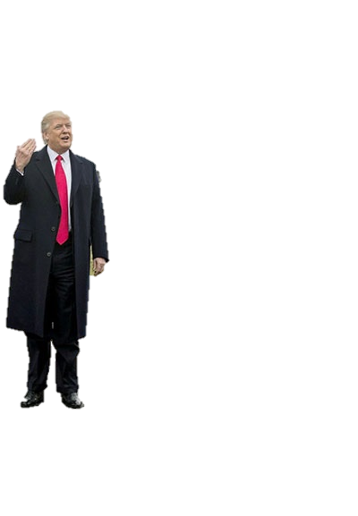

Graphing 2
This is a linear equation table, it’s ok, you will get it.
$$Y=2x−1$$
x Random Number | y
-2 | -5
-1 | -3
0 | -1
1 | 1
2 | 3

Slide 8

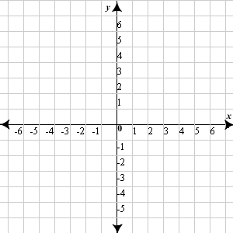


Rise
Run
1
$$Y=3x−4$$
3
-4
Slope=$\frac{Rise }{Run}$=$\frac{3}{1}$=$3$

Slide 9


Practice
$Y=x+4 y=−2x−2$
Positive mx the slope is going up.
Negative mx the slope is going down.

Slide 10
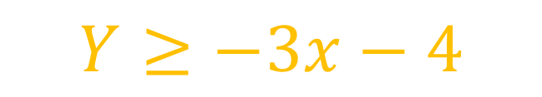
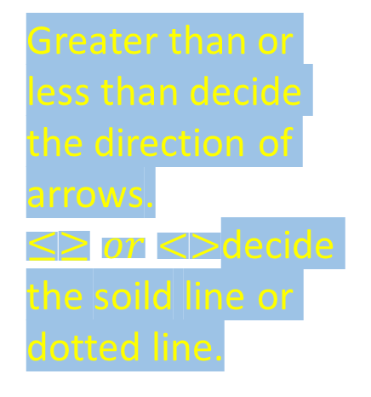

Inequality Graphing
$$Y<2x+4$$
$$Y≥−3x−4$$
Greater than or less than decide the direction of arrows.
$≤≥or<>$decide the soild line or dotted line.
Greater
Smaller

Slide 11
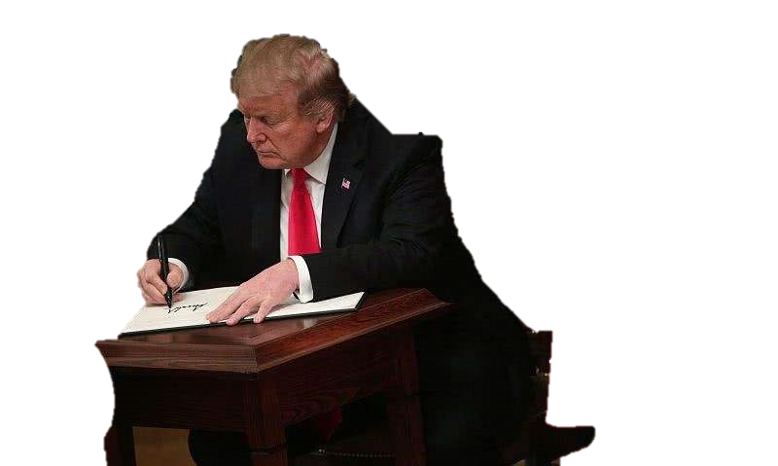
HW
See Renweb, Be ready for test tomorrow.
Struggle!

